Slide 1
COMP 55
Chapter 6 – Use Case Diagrams
Notes:
These chapters are really dry, and if they read the chapter, you should just have them do more activities that surround the lecture instead. Like have them create a feature list for an ATM for example and have them do that and then compare their diagrams

Slide 2
Agenda
Announcements
Chapter 3
Chapter 6
Activity

Slide 3
Announcements
Basecamp
Weekly Status report due between Friday & Monday
Requirements Analysis Oct 13th
Use Case Diagram and Review of Use Case on Tuesday (from Assignment)
Read Chapter 4 for Tuesday

Slide 4
My version of the use case
Partygoer

Slide 5
Partygoer arrives at the party
Partygoer opens app and goes to attendee mode
Enters party name
Looks at other songs selected and votes up songs they like, votes down songs they hate
Does not like any of the songs so suggests a new song
Closes the app
Partygoer logs back in because they haven’t heard the song, so wants to check where it is on the queue
Votes additional songs up and down.
Tries to game the system by voting all the songs down
Message pops up for a limit on number of songs voted down for the party
Song plays

Slide 6
Now try to do the Admin side
Notes:
give them like 2 minutes

Slide 7
DJ/Admin gets ready for the party
Sets up the speakers & Connects tablet to the speakers
Opens up the App and goes into Admin mode
Puts in settings for maximum number of songs in playlist, genres to exclude, and name of party
DJ/Admin decides to test the sound by playing “Never gonna give you up” by Rick Astley
DJ/Admin adjusts speaker levels to match what is wanted
DJ/Admin presses the button again and stops the music.
Waits until the party starts, and then presses the start party button, and a predefined music list starts to play
As songs are suggested they get added to the playlist, so order of songs and what is coming up changes
The party becomes a rager
Someone sets off the fire alarm
DJ/Admin must pause the music
Fire Chief says it’s ok
DJ/Admin hits play and music resumes from where it left off
DJ/Admin ends the party by stopping the music.

Slide 8
Get into groups
Have one person open up socrative

Slide 9
Answer same questions (May use notes or book)
Provide a quick summary of the chapters 3 & 6
What are the main points that were made in these chapters?
How can you apply this chapter to your upcoming project?

Slide 10
Last question
How are the points in this chapter 3 different than what was discussed in chapter 2?

Slide 11
My main ideas
For Chapter 3

Slide 12
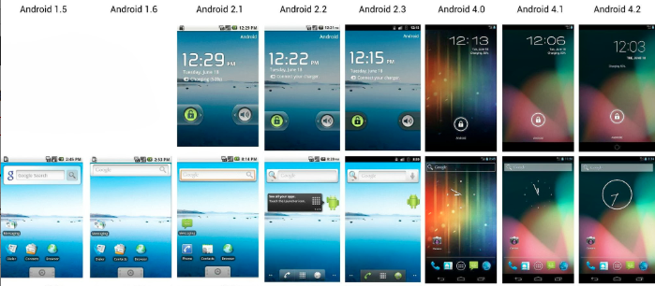
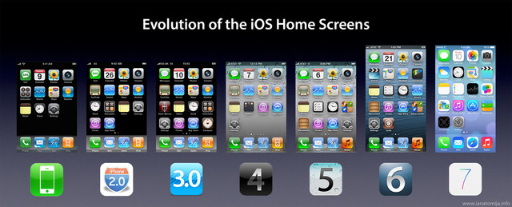

Slide 13
Bark Recognizer
What will change?
Notes:
Hardware, use case, code

Slide 14
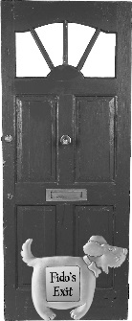

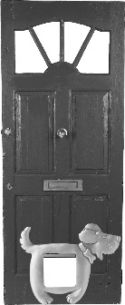


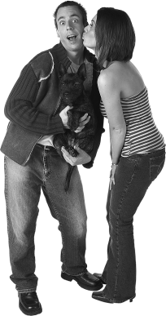
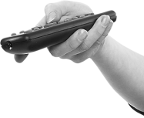
The old scenario
Gina, open the dog door…Fido won’t quit barking!
Woof! Woof!
Woof! Woof!
I feel much better now!
6.1
The door shuts automatically.
1
Fido barks to be let out.
Todd or Gina hears Fido barking.
2
3
Todd or Gina presses the button on the remote control.
6.2
Fido barks to be let back inside.
4
The dog door opens.
Again with the barking! Someone let Fido back inside
5
Fido goes outside.
6
Fido does his business.
6.3
Todd or Gina hears Fido barking (again).
6.4
Todd or Gina presses the button on the remote control.
8
The door shuts automatically.
7
Fido goes back inside.
6.5
The dog door opens (again).
Notes:
This scenario describes the way our product, as implemented at the end of the last chapter, is used. How do we need to change it for the new requirements.

Slide 15


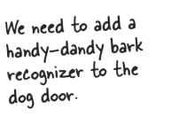

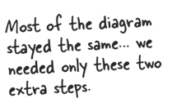
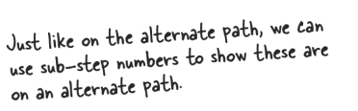
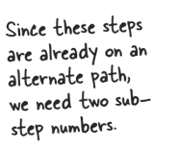
The new scenario
Gina, open the dog door…Fido won’t quit barking!
Woof! Woof!
Woof! Woof!
Todd or Gina hears Fido barking.
2
3
Todd or Gina presses the button on the remote control.
I feel much better now!
6.1
The door shuts automatically.
Fido barks to be let back inside.
1
Fido barks to be let out.
The bark recognizer “hears” a bark.
6.2
2.1
4
The dog door opens.
Again with the barking! Someone let Fido back inside
3.1
The bark recognizer sends a request to the door to open.
5
Fido goes outside.
6.3.1
The bark recognizer “hears” a bark (again).
6.4.1
The bark recognizer sends a request to the door to open.
6
Fido does his business.
6.3
Todd or Gina hears Fido barking (again).
6.4
Todd or Gina presses the button on the remote control.
7
Fido goes back inside.
8
The door shuts automatically.
6.5
The dog door opens (again).
Notes:
Here’s one way we might change the scenario. There are others that would work as well.

Slide 16
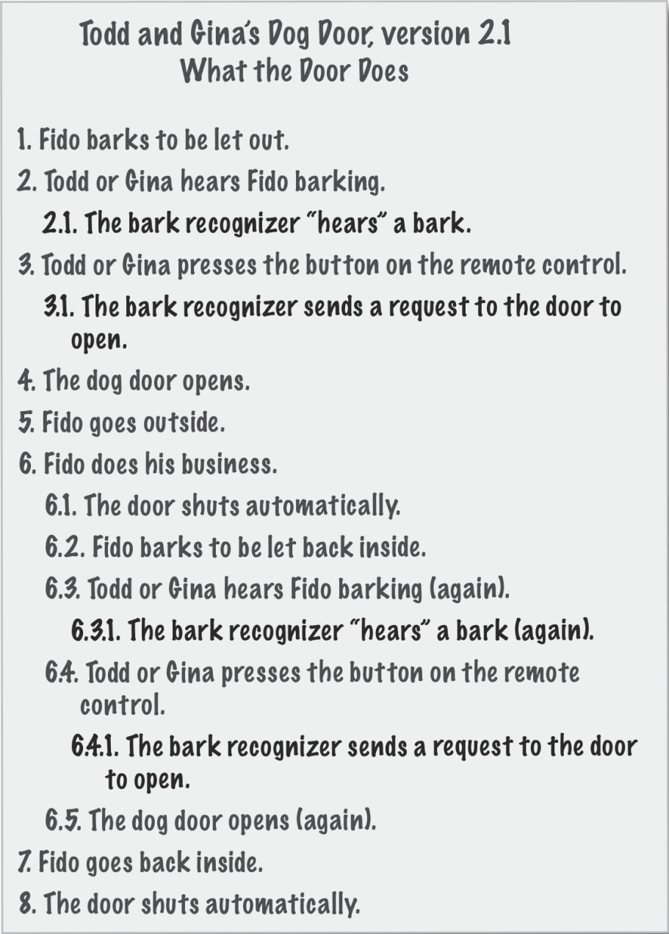
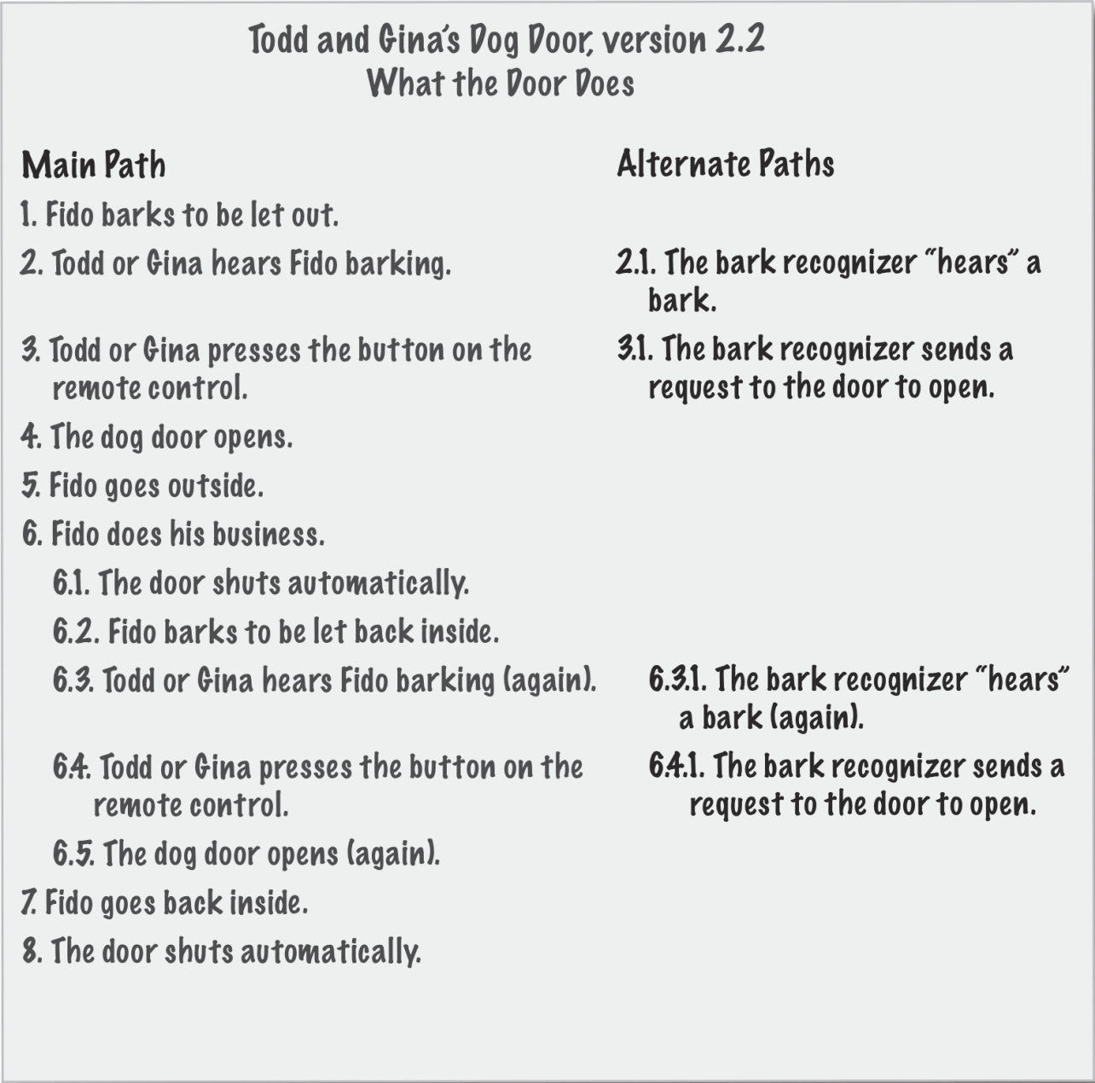
Point about use cases?
Notes:
Needs to be important to you!

Slide 17
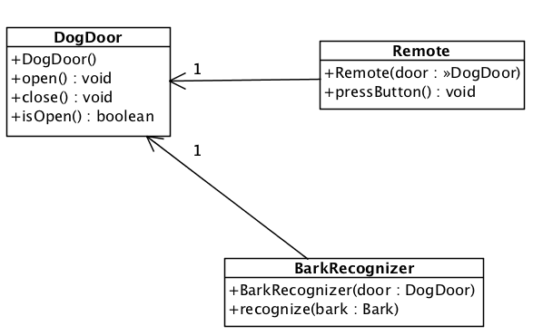
Our new design
Notes:
Here’s a new design that we want to use for our new version of the system. Make sure you understand the diagram. Is there a similarity between Remote and BarkRecognizer?
Notice that the parameter to the recognize method is an instance of a Bark and we haven’t put a Bark class in the diagram. Is this a problem? Well it is if this represented the final system. But for now, it’s okay. You’ll see when we get to the code that we’ll use a String for now, until we get the real details. In fact the code we’ve got in the book and in the slides simulates the hardware since we really don’t have the hardware. One thing we want to do in our systems is make it easy to test for correctness even when we don’t have all of the parts we need to finish the system for delivery to the customer.

Slide 18
new BarkRecognizer class
public class BarkRecognizer {
private DogDoor door;
public BarkRecognizer(DogDoor door) {
this.door = door;
}
public void recognize(String bark) {
System.out.println(" BarkRecognizer: Heard a '" + bark + "'");
door.open();
}
}
What about closing the door?
Notes:
There’s not a lot complexity here. It’s not too hard to write the code from the previous diagram. Which is easier to understand, the diagram or the code? Actually, as with most answers—it depends. It depends on what you’re trying to understand. If you want to understand how the system is organized, the diagram is a great way of getting the higher-level view; while if you really want to see how everything is implemented, you need to look at the code. On single view suffices.

Slide 19
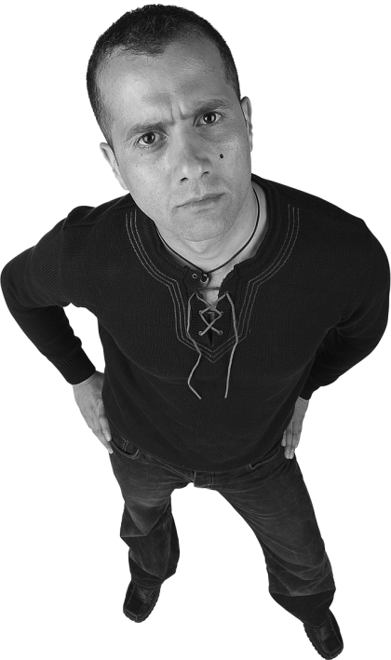
Why not follow this thought?
Just copy the code for closing the door automatically from the Remote to the BarkRecognizer.
Notes:
Maybe we happened to get lucky with our application of the Information Expert pattern on our code. If we hadn’t, the solution seems simple to Doug, who’s a manager, not a programmer. What do you think of his solution. It certainly seems simple enough. In fact that’s often the problem. People who aren’t programmers or involved with software development think that a change can just be implemented with the most obvious, simple solution (to them).

Slide 20
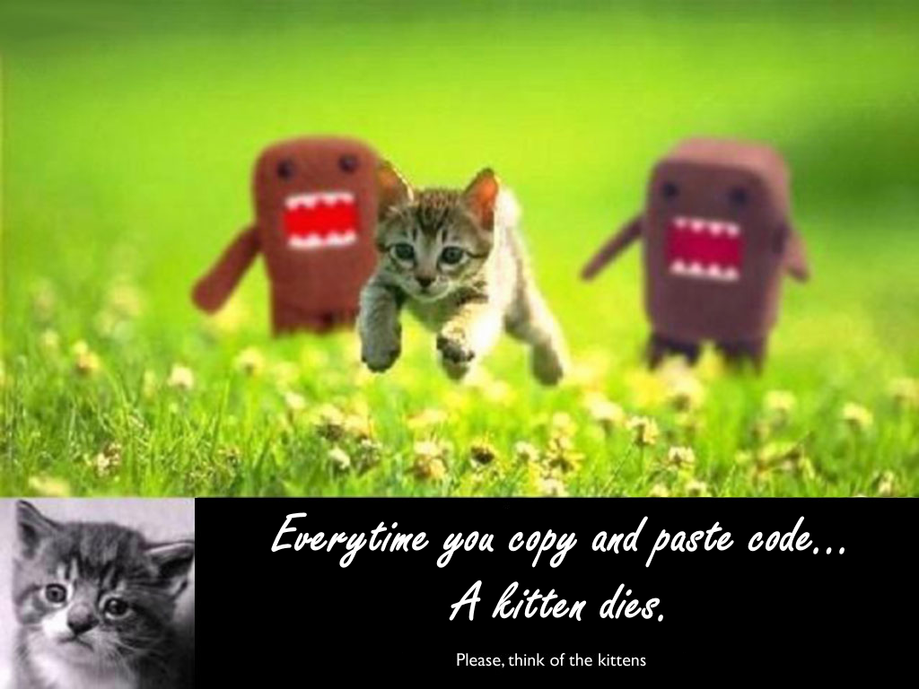
Copying and pasting code

Slide 21
What’s wrong with Doug’s idea?
1
You might copy the code incorrectly
2
You might copy it again
3
Mo copies Mo Problems
(When Requirements Change)
4
It ain’t got not alibi!
Notes:
There are a few things that we can think of that are wrong about Doug’s idea. Try to come up with your own list and see how it compares to our list.
(Answers appear on click)

Slide 22

Things to think about
Are the Remote and the BarkRecognizer similar?
Can you encapsulate the similarities?
How would this change the system?
We haven’t implemented a Bark class. How would you do that?
What do we gain from it?

Slide 23
Let’s move on to chapter 6
It’s about building bigger pieces of software

Slide 24
A requirements hierarchy
Vision
Feature
Feature
Feature
Use Case
Use Case
Use Case
Use Case
Use Case
Use Case
Notes:
Features are one type of requirement. There are usually different types of requirements that describe a system and they usually form some sort of a hierarchy. The next two slides give you a quick view of how we might organize requirements.
Here we see several levels of requirements. The highest level is the vision. The vision document, like Gary’s, is a statement that describes the long-term, high-level view of the system or enterprise. Successful businesses have vision statements that guide the way they conduct business. It defines the business by what it contributes to the marketplace. In this problem, the vision is a vision for the game framework that we are to build. This vision should be aligned with Gary’s Games company vision, but that’s not important for our purposes here.
The features are requirements that describe particular functions or capabilities of the system we’re going to build. These too are high-level requirements. There should be something in the vision that you can point to that makes the feature desirable. You may not get this directly from the vision but will need to talk to people and do a good bit of analysis to identify all of the features.
The features drive the detail requirements. Detail requirements might be written as use cases, user stories, or any other requirements technique your team decides upon. If you satisfy the detail requirements you will have implemented the features. If you implement all of the features, you will have satisfied the vision.
There’s no law that says you need to have just these three levels. You might have more or less. It turns out that three works out well for most projects. It also makes it easy to set up a traceability matrix.

Slide 25
Let’s start with an activity
We have a vision to build our own ATM machine for UOP Bank.
What would be the requirements for such an ATM?
(Limit yourselves to eight)
Notes:
Think about the features. Get in teams and do on socrative

Slide 26
My ATM Requirements
Accept debit and credit cards from any source
Charges fees to non-host institutions
Dispenses cash
Accepts deposits
Allows account transfers
Allows balance inquiries
Highly secure transactions
Multi-lingual user interface

Slide 27
Features to Use Case?

Slide 28
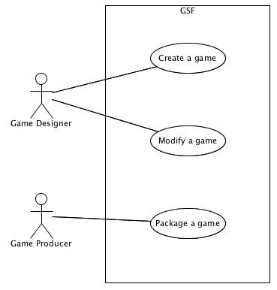
The use case diagram
Use case
Actor
System
Notes:
Here’s another diagram that’s useful for reasoning about your system. It doesn’t have a lot of detail. In fact if it begins to become too cluttered, it usually indicates that you’ve got too much detail. One should be able to look at the diagram and understand what a system is supposed to do, which actors are involved with the use cases, and so on. The other thing the use case diagram shows are clear boundaries for the system. Everything inside the system box in the diagram are things that the development team must implement in the system. If it’s not inside the box, it’s probably some other team’s responsibility. Let’s look at a simple example.
You might ask where we got the Package a game use case from. Our experience tells us that there is usually some sort of administrative use case that the customer doesn’t usually ask for explicitly.

Slide 29
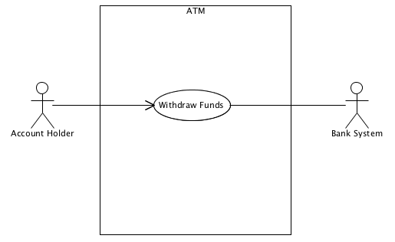
Simple ATM Example
Notes:
Here’s a simple use case diagram with a single use case. You can imagine that there are other use cases that would be within the system. We want to illustrate two things with this diagram. First, notice the use case has two actors associated with it. One is the human account holder that is using the ATM and the other is the bank’s software system at the bank that will handle transactions about finding out whether the user has enough money in her account, and so on. Since there are two actors we place an arrow from the Account Holder to the use case. This tells us that the Account Holder is the actor that initiates the use case.
The second thing we want to stress is that there can be non-human actors. In fact the bank system has a lot of behavior that we’ll need to implement the ATM software, but since it’s outside of the system box, we know that the responsibility for developing it is not our team’s responsibility. However, it’s also important to realize that it is our responsibility to work with the Bank System’s developers to make sure we have the right interfaces defined for our system to work with theirs.

Slide 30
Now that you have requirements, each one of you come up with a use case diagram to help explain the atm machine. Include name & Use either draw.io, powerpoint, or paint, make sure you have a picture.

Slide 31
Make use case diagram w/ these features
Deposit Money from Account
Withdraw Money from Account
Spits out only singles to make you feel better about yourself
ATM validates bills to make sure they're real
If are the 777th person to withdraw, you will get extra money.
Defense system. ATM Equipped with lethal gasses
Maximum withdrawal amount
You should be able to play a game on the ATM Machine

Slide 32
Upload that picture to google sheet link here http://bit.ly/55usecaselecture
Notes:
Maybe start a google sheets slide with each team, need to bring in scanner.

Slide 33
Look over team members diagrams

Slide 34
My main ideas

Slide 35
Chapter 6
Big problems

Slide 36
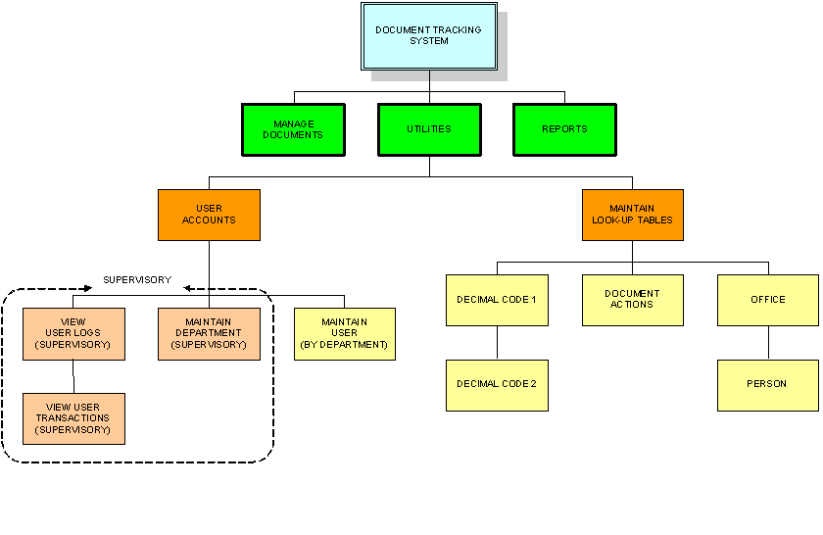
Decomp!

Slide 37
Gary’s games
What was this about?
Notes:
Let them create it

Slide 38

Your customer and what they want
Notes:
O Brother where art thou episode season 2: (show video you have recorded) Homer finds long lost bro, who is very successful CEO of like GM, decides he wants to have homer design a car that he wants. Homer goes back to his team of engineers and tells them what he wants. Like a place to put his drink. Not a little cup, but one of those super-slurpers at the Kwik-E-Mart. And all sorts of other amazingly tacky things... Some things are so snazzy they never go out of style! Like tail fins... And bubble domes... And shag carpeting...
I want a horn here, here, and here. You can never find a horn when you're mad. And they should all play `La Cucaracha'. -- Homer, designing a car, ``Oh Brother, Where Art Thou?'' Advisor: What about a separate soundproof bubble-dome for the kids with optional restraints and muzzles? Homer: Bullseye!

Slide 39
Listen to them
Sit-in on interviews
Good at explaining problems and issues

Slide 40
A requirements hierarchy
Vision
Feature
Feature
Feature
Use Case
Use Case
Use Case
Use Case
Use Case
Use Case
Notes:
Features are one type of requirement. There are usually different types of requirements that describe a system and they usually form some sort of a hierarchy. The next two slides give you a quick view of how we might organize requirements.
Here we see several levels of requirements. The highest level is the vision. The vision document, like Gary’s, is a statement that describes the long-term, high-level view of the system or enterprise. Successful businesses have vision statements that guide the way they conduct business. It defines the business by what it contributes to the marketplace. In this problem, the vision is a vision for the game framework that we are to build. This vision should be aligned with Gary’s Games company vision, but that’s not important for our purposes here.
The features are requirements that describe particular functions or capabilities of the system we’re going to build. These too are high-level requirements. There should be something in the vision that you can point to that makes the feature desirable. You may not get this directly from the vision but will need to talk to people and do a good bit of analysis to identify all of the features.
The features drive the detail requirements. Detail requirements might be written as use cases, user stories, or any other requirements technique your team decides upon. If you satisfy the detail requirements you will have implemented the features. If you implement all of the features, you will have satisfied the vision.
There’s no law that says you need to have just these three levels. You might have more or less. It turns out that three works out well for most projects. It also makes it easy to set up a traceability matrix.

Slide 41
Introduction to traceability
 | F1 | F2 | F3 | F4 | F5 | F6 | F7 | F8
U1 |  |  | 
U2 |  | 
U3 |  |  |  | 
U4 |  |  |  |  | 
U5 |  |  |  |  |  | 
U6 |  |  |  |  |  |  | 
U7 |  |  |  |  |  |  | 
U8 |  |  |  |  |  |  |  | 
U9 |  |  |  |  |  |  |  | 
U10 |  |  |  |  |  |  |  | 
Notes:
There is an important concept in managing a project. You want to make sure that everything you do contributes to the project’s goals (i.e. satisfies the requirements). One way we do this on large projects is by tracking the dependencies between artifacts like requirements, modules, tests, and so on. This is called traceability. Traceability matrices like this one are easy to create and provide an easy-to-read view of how two types of artifacts relate to each other. A common use of traceability is to trace use cases or user stories back to their feature requirements. That’s what we’ve done here.
This matrix shows that there are eight features, F1-F8 and ten use cases U1-U10. The  character in a cell shows that the use case in the row is needed to satisfy (contributes to) the feature en the column. (Actually, you can make the arrows point either way. The way we have it says that use cases trace back to features. If you changed the direction of the arrows it would say that the features generate or derive the use cases. Two ways of saying the same thing.) So, use case U1 contributes to satisfying features F1 and F3. There is much information one can get from looking at a traceability matrix. In this one, we can see that if we want all of feature F7 implemented we need to implement use cases U6-U7. However if we want feature F6, we only need to implement use case U5.
When we plan our work and prioritize the effort, this information is valuable to ensure that we are building a working product incrementally rather than ending up with a product that is 80% done, but nothing actually works.
There is one other thing you can get from a traceability matrix quickly. If you have an empty column, it means you have no use cases that help satisfy that feature. If you have an empty row, you’ve described a use case that contributes nothing to the set of features your customer want.

Slide 42
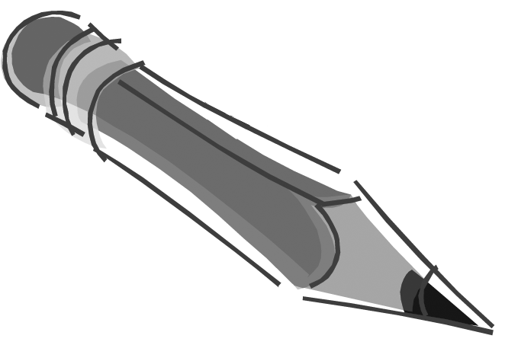
GSF Features
1
2
3
4
5
6
Notes:
Using Gary’s vision statement and the transcript of the customer conversation, extract features the customer wants in the Game System Framework. Do this in your groups

Slide 43
GSF Features
1
Support various terrain types
2
Game-specific unit type support
3
Boards with squares of various terrain types
4
Various historical and fictitious scenarios
5
Support for add-on modules and scenarios
6
GSF manages administrative details
Notes:
Here’s the set we came up with. Yours might be different. The way we’ve described them here is different than in the book but they say the same thing. At some point you will probably want to add details to make the descriptions more specific and unambiguous.

Slide 44
Traceability exercise
 | F1 | F2 | F3 | F4 | F5 | F6
U1
U2
U3
Notes:
Using our six features and three use cases (number the use cases from top to bottom in the use case diagram), fill in the traceability matrix here.

Slide 45
Traceability exercise
 | F1 | F2 | F3 | F4 | F5 | F6
U1 |  |  |  |  | 
U2 |  |  |  |  | 
U3
Notes:
Here are our answers. Notice that U3: “Package a game” does not support any of the features. When your discuss this with your customer it might lead to additional features that the user hasn’t thought of yet. Some of these might be:
The games created by the framework will play on various systems like Windows, Mac OS, and Linux systems.
The game framework and games created by it will be available on CD, DVD, and by download.
Notice also that none of the use cases supports feature F6: “GSF manages administrative details.” Administrative details are keeping track of who is moving, what move it is, or some other type of time management, ensuring that the rules are obeyed, etc. We could argue that U1: “Create a game” includes the feature, but it’s not clear that this is the case. It’s not wrong if you decide that it does, but you need to make sure that your customer and anyone who works on the system knows this.

Slide 46

Can’t we just create a new use case like “Manage administrative details?”
But what’s it’s visible value and who is the actor?
I think there is a use case and a new actor that will fit here.
What do you think the new use case and actor are?

Slide 47
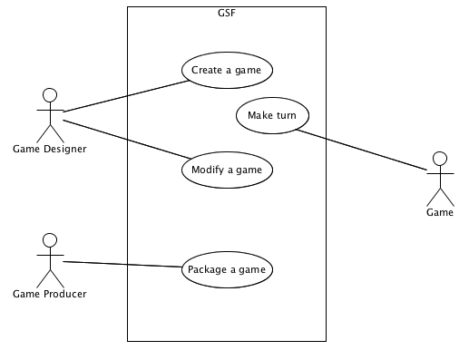
Revised use case diagram
Notes:
Managing administrative details is something that the GSF must do, but it is not something that directly affects creating or modifying a game. When you design a game, you might specify what the details are but you don’t actually “manage” them. Managing the administrative details surfaces when a game is being played. Therefore, the Game actor is a game created by the Game Designer using GSF. It uses the GSF features to manage the game.
You might think that the use case might be better names as “Play game” but that is something that a game player does, not the game. And the game player would not be using the GSF directly (or even to their knowledge). The game, however, gets value from executing a turn. In the text, we showed three other use cases, Create Board, Move Units, and Add/Remove Units. We’ve left them out here and will let you decide whether to add them or not.

Slide 48
Domain Analysis
Studying and understanding how a particular concept or topic works
Notes:
This is all well and good as long as you realize that a domain is an area of common interest. For example software development is a domain, knitting is a domain, and game development is a domain. Each domain has its own concepts and terminology that people working within the domain use to communicate effectively. For example the terms compiler and pointer have special meaning to programmers than it does to non-programmers.

Slide 49
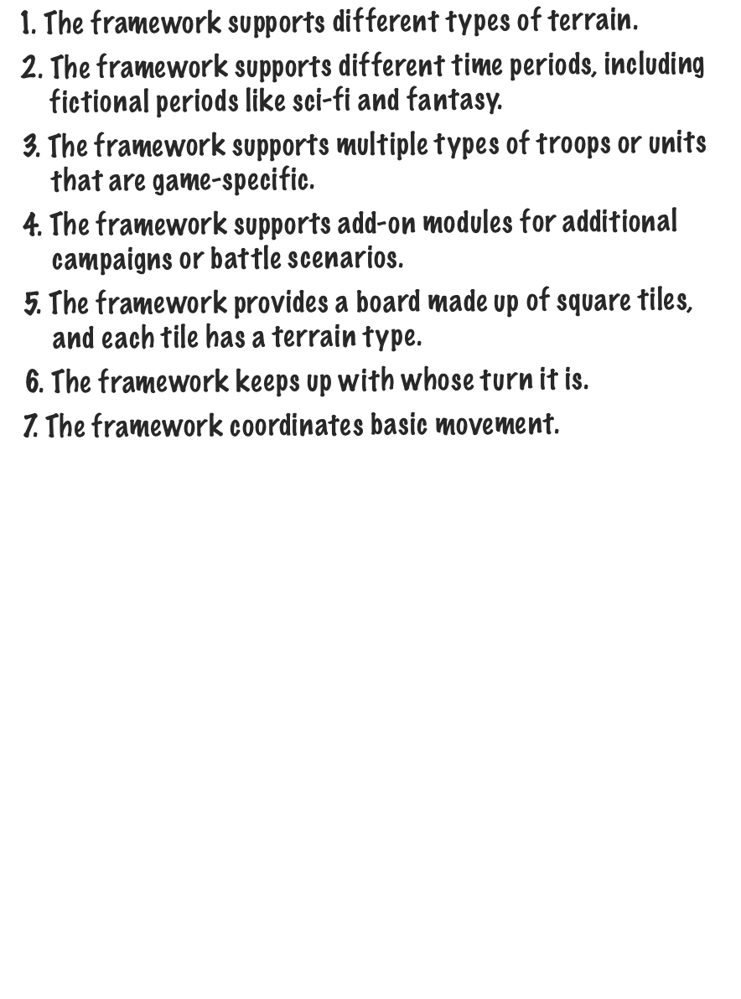
Feature list in domain’s terms
Notes:
Gary doesn’t care about classes at this point. In fact, he may never care about classes and objects, but the developers need to know about them. What Gary cares about are games and how they’re designed. He wants to know that you have an understanding of his problem and requirements. Using the use case diagram and this feature list you can give Gary the warm and fuzzy feelings he needs to give you the okay to continue with the project.

Slide 50
Rest of class Start making a use case diagram and working on requirements analysis I’ll review them on Tuesday

